Slide 1
Dynamic
Gomory-Hu Tree
Soham Chakraborty
22CS02002
Supervisor: Dr. Joy Chandra Mukherjee

Slide 2
Table of Contents
Network Flow
Multi-Terminal Network Flow
Gomory-Hu Tree
Dynamic Gomory-Hu Tree
Applications
References

Slide 3
Network Flow
Network Flow - A flow in a network is a collection of simple path flows between 2 fixed endpoints which has the property that the “sum of the numbers of all path flows that contain any edge is no greater than the capacity of that edge”.
Value of flow is the sum of the numbers of all the path flows which compose it.
Max Flow is the maximum possible value of flow in a network over all possible flow values between 2 fixed endpoints.

Slide 4
Multi-Terminal Network Flow
Multi-Terminal Network Flow refers to the computation of flow values between all pairs of nodes in a network.
Brute Force Solution:-
  Consider all pairs of nodes and then compute max flow between them, resulting in an overall Time complexity of –
  ^{n}C₂ * O(max_flow)
  In other words, we have to do a total of ^{n}C₂ flow computations.

Slide 5
Gomory-Hu Cut Tree
Gomory-Hu Tree is a tree which solves the problem of computation of Multi-Terminal Network Flows for an undirected graph having capacity(i,j) = capacity(j,i) with only (n-1) flow computations.
Time Complexity of Construction – (n-1) * O(max_flow)
Motivation - There exists only (n-1) numerically different flow values in a Graph.

Slide 6
Properties
For any 2 vertices, the min-Cut separating those vertices in the tree is also a valid min-Cut in the corresponding graph.
Flow between any 2 vertices in the graph is numerically equal
to the minimum edge capacity on the path between those 2
vertices in the corresponding Cut-Tree.
Mathematical Representation - f(u,v) = min_{e } _{π(u,v)} c(e)

Slide 7
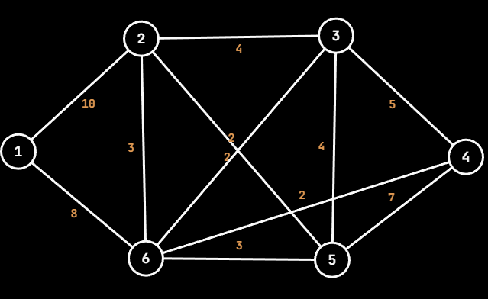
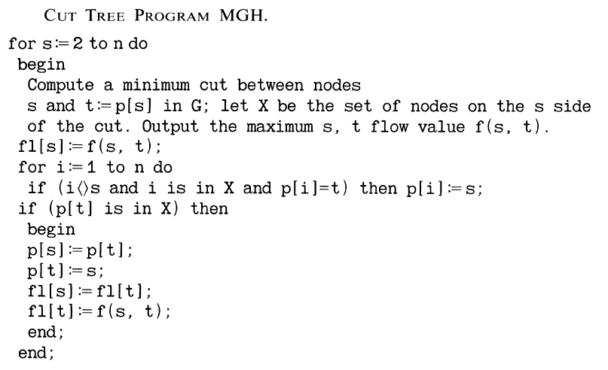
Construction of Gomory-Hu Tree
The following construction is as described by Gusfield in his paper, which is an easier implementation of Cut-Tree.

Slide 8
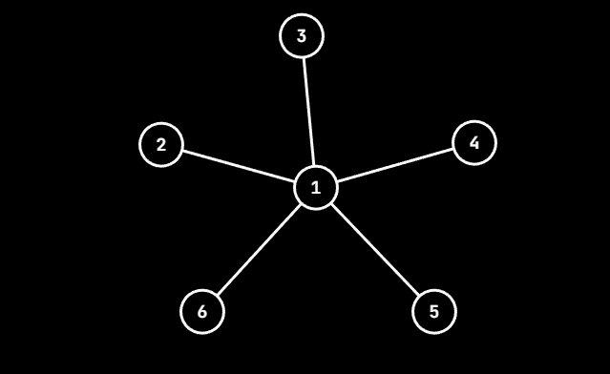
Construction
Array\Node | 2 | 3 | 4 | 5 | 6
p | 1 | 1 | 1 | 1 | 1
fl | - | - | - | - | -
Initialization:
- Create a star graph.
- Set all p (parent) to 1.
- fl represents the edge weights from node to parent.
- fl is empty as no flow values have been computed yet.

Slide 9
Construction
Array\Node | 2 | 3 | 4 | 5 | 6
p | 1 | 1 | 1 | 1 | 1
fl | - | - | - | - | -
s = 2 t = p[s] = 1
S = {2,3,4,5,6} T = {1}
min-Cut = 18
Update p, fl

Slide 10
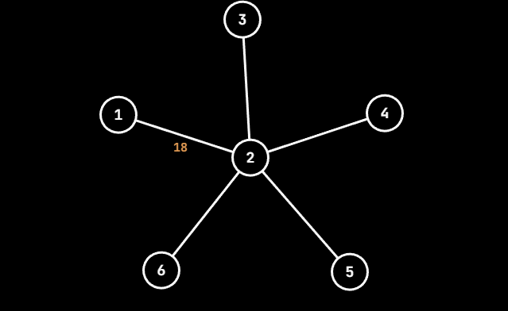
Construction
Array\Node | 2 | 3 | 4 | 5 | 6
p | 1 | 2 | 2 | 2 | 2
fl | 18 | - | - | - | -
s = 3 t = p[s] = 2
S = {3,4,5} T = {1,2,6}
min-Cut = 13
Update p, fl

Slide 11
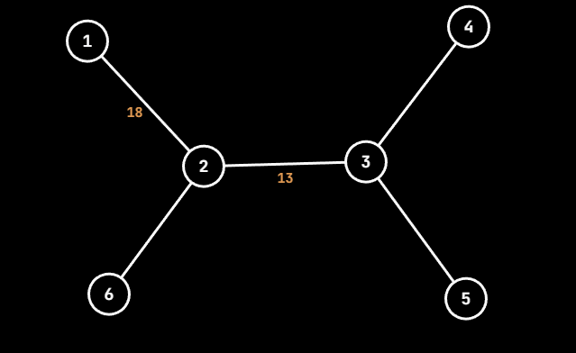
Construction
Array\Node | 2 | 3 | 4 | 5 | 6
p | 1 | 2 | 3 | 3 | 2
fl | 18 | 13 | - | - | -
s = 4 t = p[s] = 3
S = {4} T = {1,2,3,5,6}
min-Cut = 14
Update p, fl

Slide 12
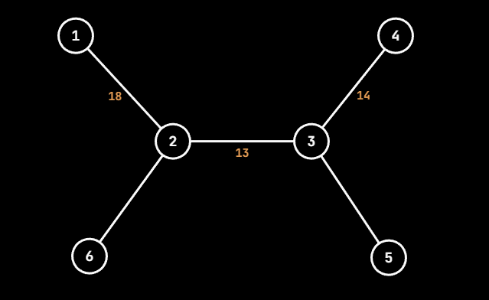
Construction
Array\Node | 2 | 3 | 4 | 5 | 6
p | 1 | 2 | 3 | 3 | 2
fl | 18 | 13 | 14 | - | -
s = 5 t = p[s] = 3
S = {1,2,4,5,6} T = {3}
min-Cut = 15
Update p, fl

Slide 13
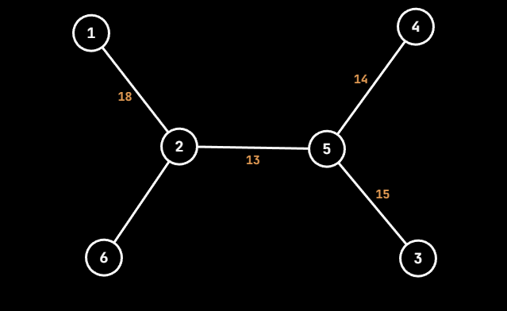
Construction
Array\Node | 2 | 3 | 4 | 5 | 6
p | 1 | 5 | 5 | 2 | 2
fl | 18 | 15 | 14 | 13 | -
s = 6 t = p[s] = 2
S = {3,4,5,6} T = {1,2}
min-Cut = 17
Update p, fl

Slide 14
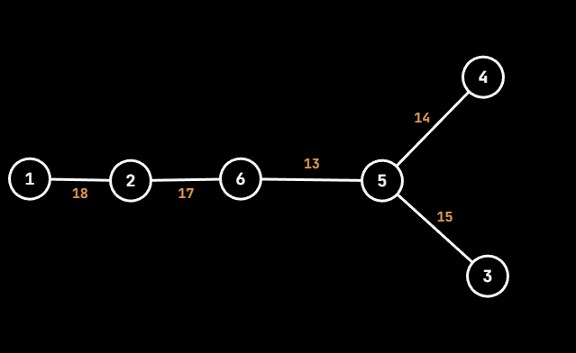
Construction
Array\Node | 2 | 3 | 4 | 5 | 6
p | 1 | 5 | 5 | 6 | 2
fl | 18 | 15 | 14 | 13 | 17
Terminate

Slide 15
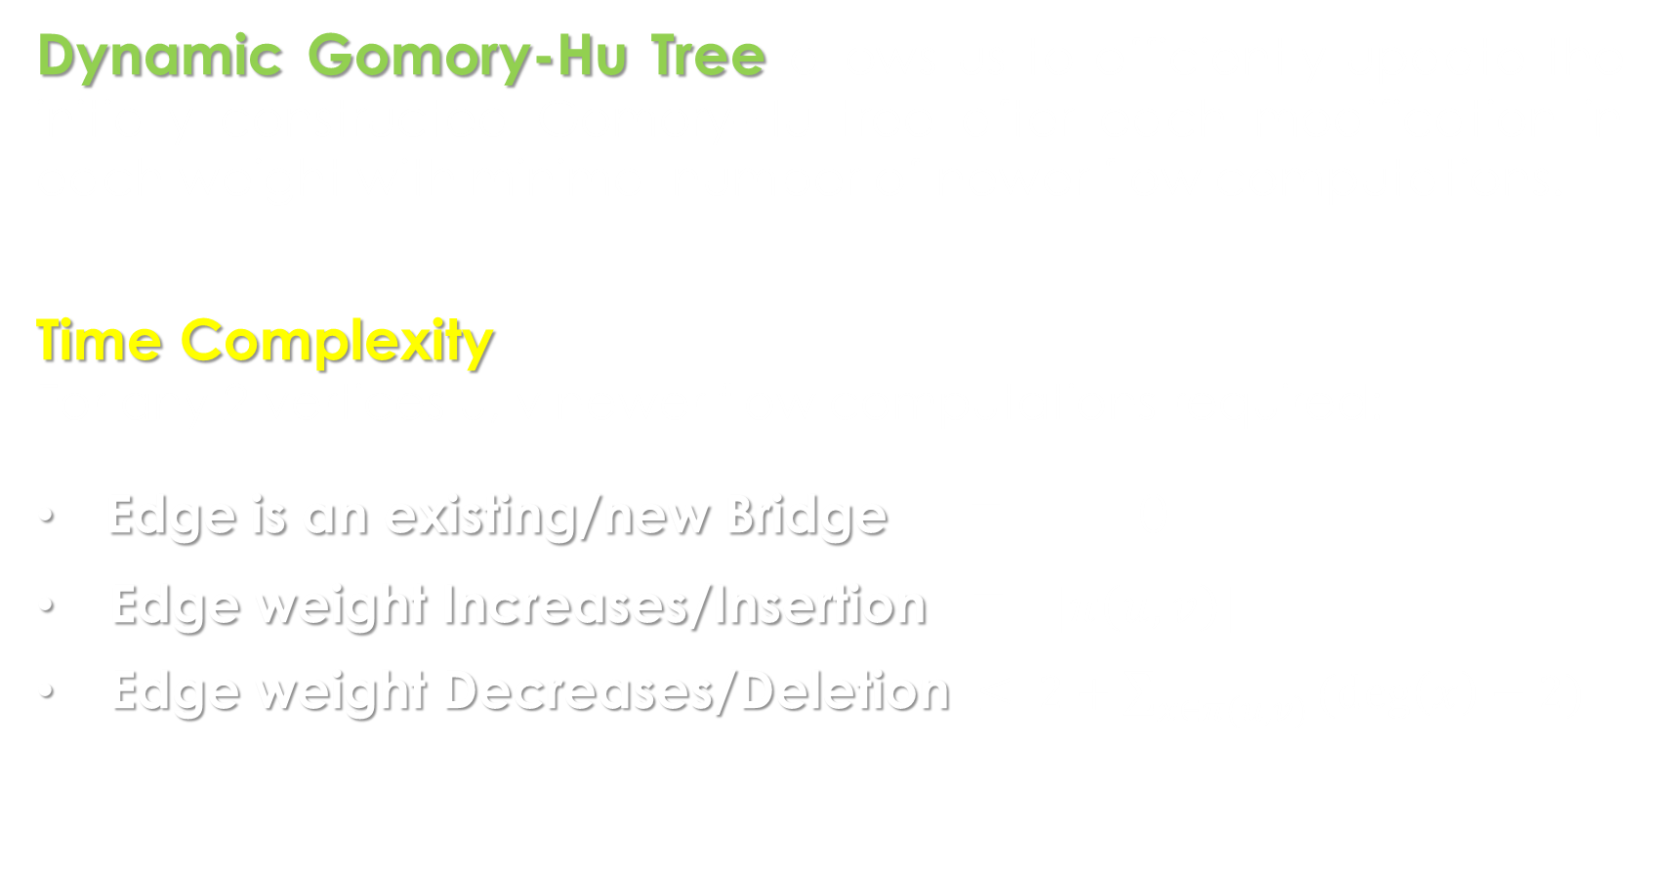
Dynamic Gomory-Hu Tree
Dynamic Gomory-Hu Tree allows us to efficiently update the initially constructed Gomory-Hu tree after each modification in each weight with minimal number of newer flow computations.
Time Complexity
For any 2 vertices u, v newer flow computations required:
Edge is an existing/new Bridge = 0
Edge weight Increases/Insertion = $|π\left(u,v\right)|$
Edge weight Decreases/Deletion $≤ 2+\sum_{x∈π(u,v)}{(deg\left(x\right)−2)}$

Slide 16
Construction of Dynamic Gomory-Hu Tree
We will start with the initially constructed Gomory-Hu tree and show construction in the following 2 cases:
Existing Edge weight increases
Existing Edge weight decreases

Slide 17
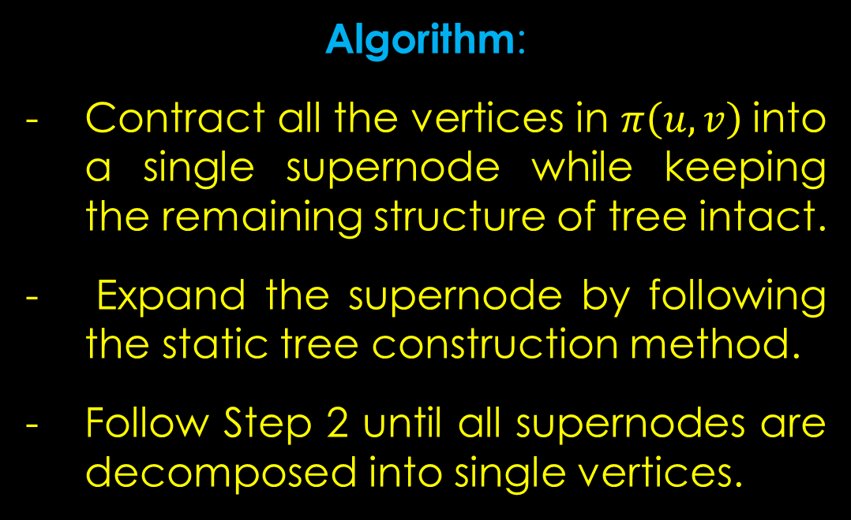
Increase (2,3) by 3
 | 1 | 2 | 3 | 4 | 5 | 6
p | - | 1 | 5 | 5 | 6 | 2
fl | - | 18 | 15 | 14 | 13 | 17
Algorithm:
Contract all the vertices in $π\left(u,v\right)$into a single supernode while keeping the remaining structure of tree intact.
Expand the supernode by following the static tree construction method.
Follow Step 2 until all supernodes are decomposed into single vertices.

Slide 18
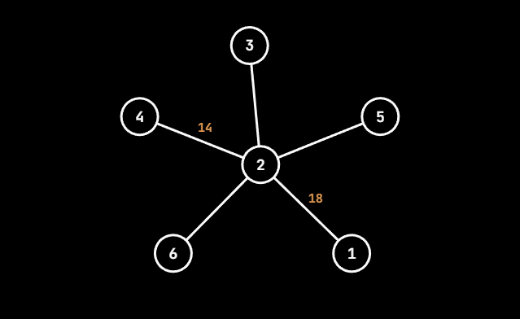
Increase
 | 1 | 2 | 3 | 4 | 5 | 6
p | 2 | 2 | 2 | 2 | 2 | 2
fl | 18 | - | - | 14 | - | -
s = 3 t = p[s] = 2
S = {3,4,5} T = {1,2,6}
min-Cut = 16
Update p, fl

Slide 19
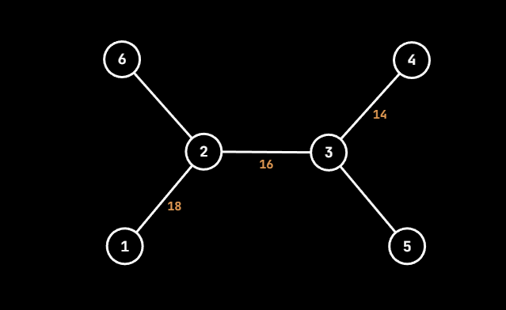
Increase
 | 1 | 2 | 3 | 4 | 5 | 6
p | 2 | 2 | 2 | 3 | 3 | 2
fl | 18 | - | 16 | 14 | - | -
s = 5 t = p[s] = 3
S = {5} T = {1,2,3,4,6}
min-Cut = 16
Update p, fl

Slide 20
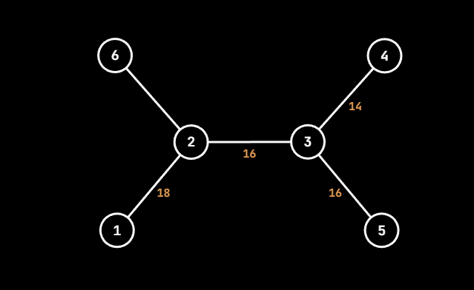
Increase
 | 1 | 2 | 3 | 4 | 5 | 6
p | 2 | 2 | 2 | 3 | 3 | 2
fl | 18 | - | 16 | 14 | 16 | -
s = 6 t = p[s] = 2
S = {6} T = {1,2,3,4,5}
min-Cut = 18
Update p, fl

Slide 21
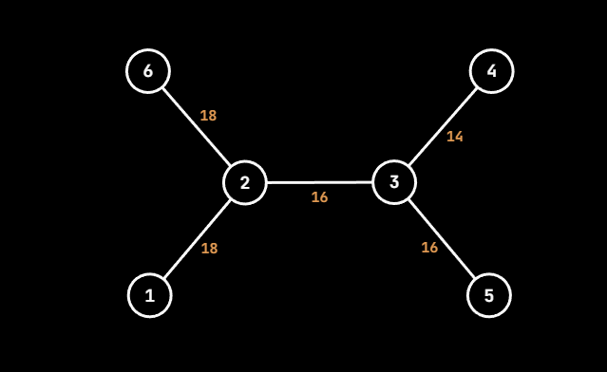
Increase
 | 1 | 2 | 3 | 4 | 5 | 6
p | 2 | 2 | 2 | 3 | 3 | 2
fl | 18 | - | 16 | 14 | 16 | 18
Terminate

Slide 22
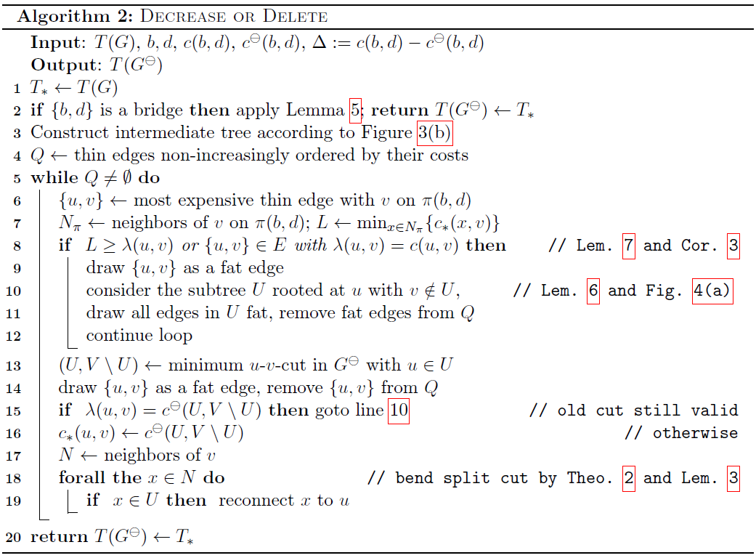
Decrease (5,6) by 2

Slide 23
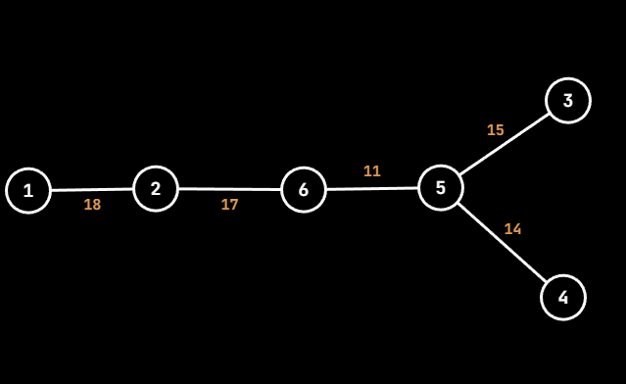
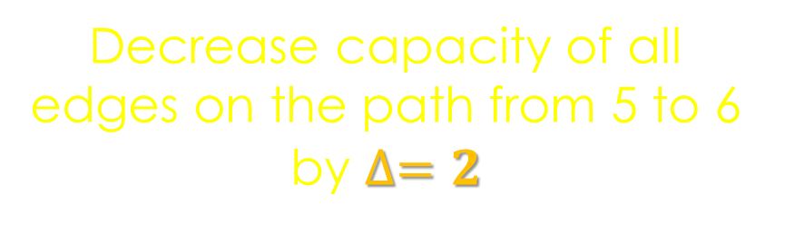

Decrease (5,6) by $∆=2$
Decrease capacity of all edges on the path from 5 to 6 by $∆=2$

Slide 24
Decrease
Q = { (6,2) , (5,3) , (5,4) }
v = 6 u = 2
V = {6} U = {1,2,3,4,5}
min-Cut = 16
- Update c*(6,2) = 16
- Reconnect 5 to 2
- Erase top element from Q
- Insert (2,1) to Q

Slide 25
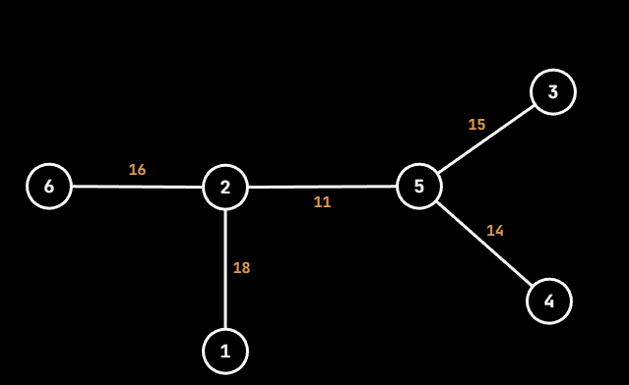
Decrease
Q = { (2,1) , (5,3) , (5,4) }
v = 2 u = 1
min-Cut = 18
- Erase top element from Q
Insert (2,1) to Q
Current-Cut = previous-Cut
Skip (Line 15)

Slide 26
Decrease
Q = { (5,3) , (5,4) }
v = 5 u = 3
V = {4,5} U = {1,2,3,6}
min-Cut = 14
- Update c*(5,3) = 14
- Reconnect 2 to 3
- Erase top element from Q

Slide 27
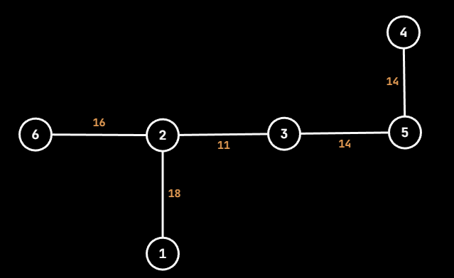
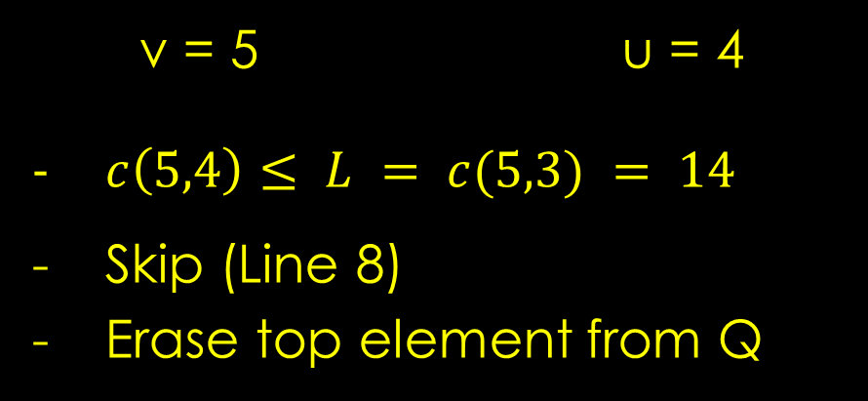
Decrease
Q = { (5,4) }
v = 5 u = 4
$c\left(5,4\right)≤ L = c(5,3) = 14$
Skip (Line 8)
Erase top element from Q

Slide 28
Decrease
Q = { }
Q is empty
Terminate

Slide 29
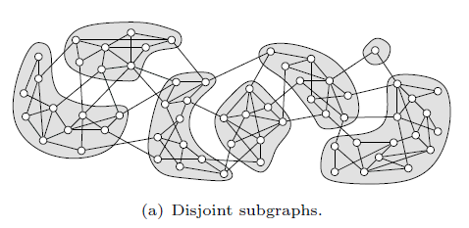
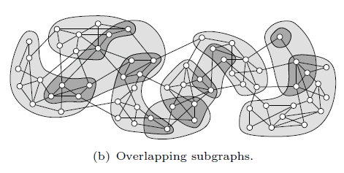
Future Works
Graph Clustering – Decomposing a given graph into somehow dense subgraphs called clusters.
Cut-based clustering algorithm (Flake clustering) is used for:
Finding good clusters in general graphs, which are further used for optimizations in NP-hard problems.
Hierarchies of clusters in overlapping
subgraphs.

Slide 30
Applications
Community Detection
Network Reliability and Resilience analysis
Computer vision (image segmentation in videos)
Clustering of protein structures into strongly connected groups, to identify real PPI.

Slide 31
References
L. R. FORD, JR. AND D. R. FULKERSON, Maximal flow through a network, Canad.J. Math., 8 (1956), pp. 399-404
R.E. GOMORY AND Z. C. HU, Multi-terminal network flows, SIAM J. Appl. Math., 9 (1961), pp. 551-570
Dan Gusfield. Very simple methods for all pairs network flow analysis. SIAM Journal on Computing, 19(1):143-155, 1990
Hartmann T, Wagner D (2013) Dynamic Gomory–Hu tree construction—fast and simple.
Tanja Hartmann Algorithms for graph connectivity and cut problems (2014)

Slide 32
Thank You

